Slide 1
Interprocessor Arbitration

Slide 2
Interprocessor Arbitration
Buses
What is Bus?
A memory bus consists of lines for transferring data, address, and read/write information.
An I/O bus is used to transfer information to and from input and output devices.
A system bus connects major components in a multisystem bus processor system, such as CPUs, IOPs, and memory. A typical system bus consists of approximately 100 signal lines. These lines are divided into three functional groups: data, address, and control.
Bus conflict?
Arbitration logic resolves bus conflict
It would be the part of system bus controller
System Bus & Data transfers
synchronous bus (common clock source)
asynchronous bus (handshaking control signals)
Based on M. Morris Mano “Computer System Architecture”--Assist. Lecturer Ahmed Salah Hameed

Slide 3
Interprocessor Arbitration
Arbitration logic resolves bus conflict
It would be the part of system bus controller
Arbitration logic (Two types)
Serial arbitration procedure (daisy-chain connection):
The processors connected to the system bus are assigned priority according to their position along the priority control line. The device closest to the priority line is assigned the highest priority.
Parallel arbitration procedure
Arbitration procedures services all processor requests on the basis of established priorities
Based on M. Morris Mano “Computer System Architecture”--Assist. Lecturer Ahmed Salah Hameed

Slide 4
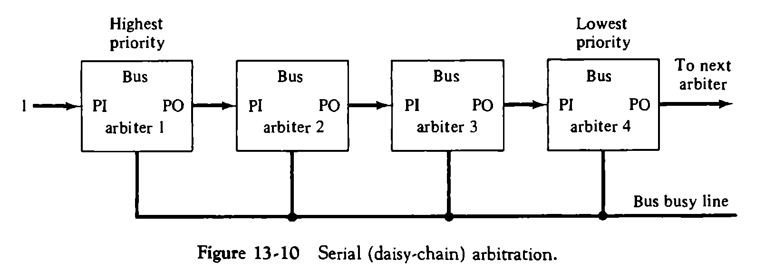
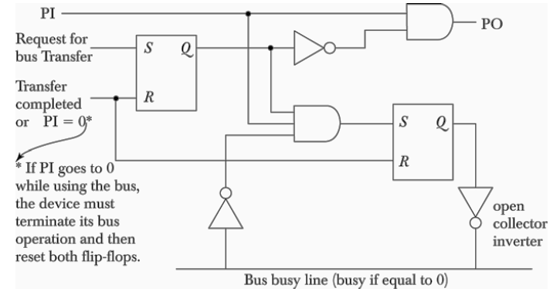
Serial arbitration procedure
Based on M. Morris Mano “Computer System Architecture”--Assist. Lecturer Ahmed Salah Hameed

Slide 5
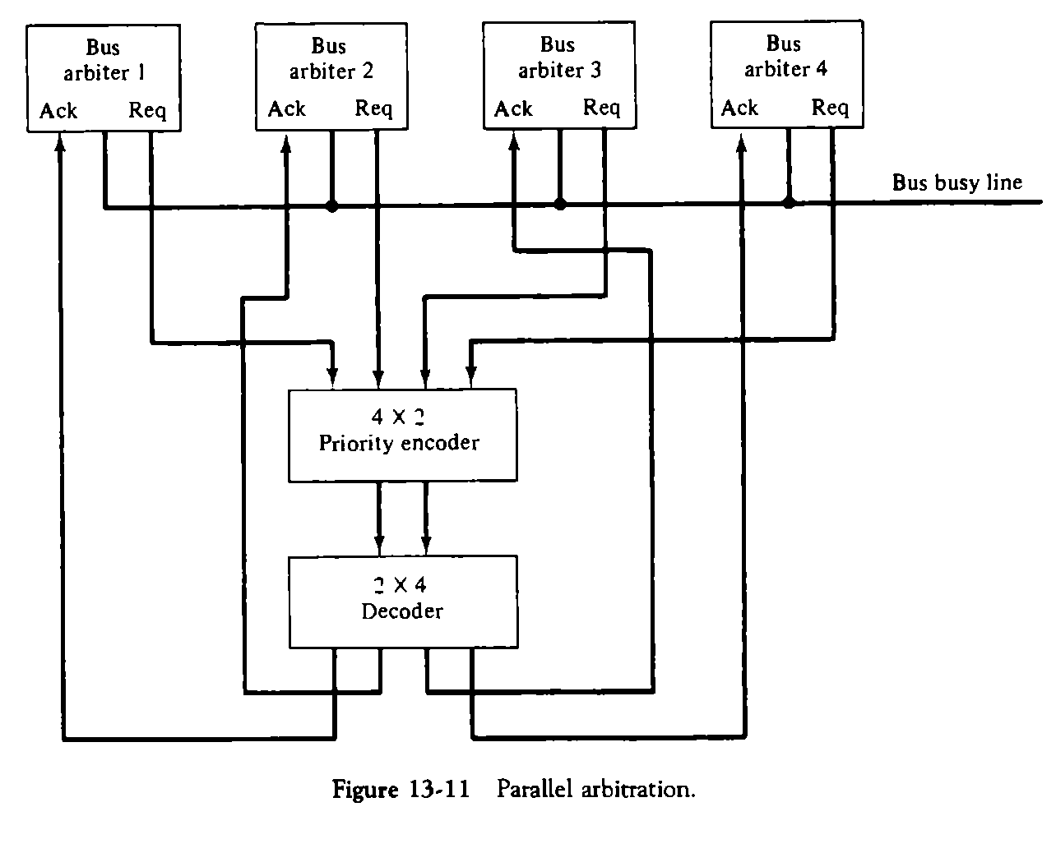
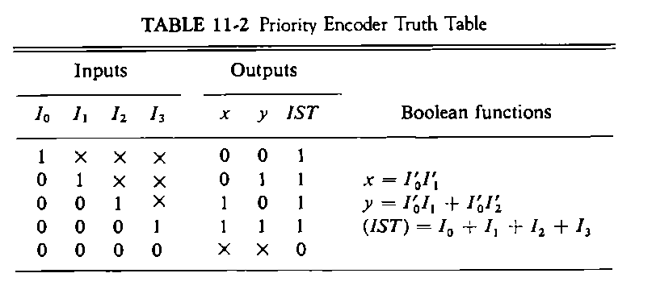
Parallel arbitration procedure
Based on M. Morris Mano “Computer System Architecture”--Assist. Lecturer Ahmed Salah Hameed

Slide 6
Dynamic Arbitration Algorithms
Static priority (Serial and Parallel)
Dynamic Arbitration Algorithms:
The time slice algorithm
Polling algorithm
The least recently used (LRU) algorithm
The first-come, first-serve (FIFO) algorithm
The rotating daisy-chain procedure
Based on M. Morris Mano “Computer System Architecture”--Assist. Lecturer Ahmed Salah Hameed

Slide 7
Dynamic Arbitration Algorithms
The time slice algorithm
It allocates a fixed-length time slice of bus time that is offered sequentially to each processor, in round-robin fashion. The service given to each system component with this scheme is independent of its location along the bus. No preference is given to any particular device since each is allotted the same amount of time to communicate with the bus.
Polling
In a bus system that uses polling, the bus grant signal is replaced by a set of lines called poll lines which are connected to all units. These lines are used by the bus controller to define an address for each device connected to the bus. The bus controller sequences through the addresses in a prescribed manner. When a processor that requires access recognizes its address, it activates the bus busy line and then accesses the bus. After a number of bus cycles, the polling process continues by choosing a different processor. The polling sequence is normally programmable, and as a result, the selection priority can be altered under program control.
Based on M. Morris Mano “Computer System Architecture”--Assist. Lecturer Ahmed Salah Hameed

Slide 8
Dynamic Arbitration Algorithms
LRU The least recently used (LRU) algorithm
It gives the highest priority to the requesting device that has not used the bus for the longest interval. The priorities are adjusted after a number of bus cycles according to the LRU algorithm. With this procedure, no processor is favored over any other since the priorities are dynamically changed to give every device an opportunity to access the bus.
FIFO
In the first-come, first-serve scheme, requests are served in the order received. To implement this algorithm, the bus controller establishes a queue arranged according to the time that the bus requests arrive. Each processor must wait for its turn to use the bus on a first-in, first-out (FIFO) basis.
Based on M. Morris Mano “Computer System Architecture”--Assist. Lecturer Ahmed Salah Hameed

Slide 9
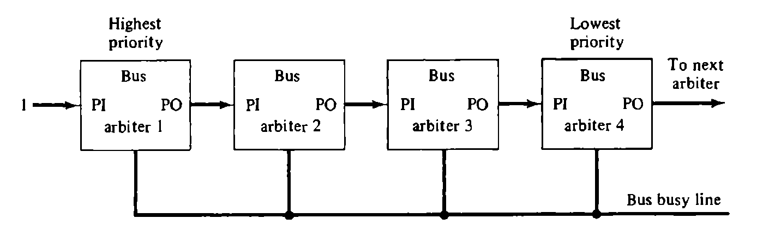
Dynamic Arbitration Algorithms
Rotating daisy-chain
The rotating daisy-chain procedure is a dynamic extension of the daisy- chain algorithm. In this scheme there is no central bus controller, and the priority line is connected from the priority-out of the last device back to the priority-in of the first device in a closed loop. This is similar to the connections of the daisy- chain shown except that the PO output of arbiter 4 is connected to the PI input of arbiter 1. Whichever device has access to the bus serves as a bus controller for the following arbitration. Each arbiter priority for a given bus cycle is determined by its position along the bus priority line from the arbiter whose processor is currently controlling the bus. Once an arbiter releases the bus, it has the lowest priority.
Based on M. Morris Mano “Computer System Architecture”--Assist. Lecturer Ahmed Salah Hameed

Slide 10
Interprocessor Communication & Synchronization
Communication refers to the exchange of data between different processes. For example, parameters passed to a procedure in a different processor constitute interprocessor communication.
Synchronization refers to the special case where the data used to communicate between processors is control information. Synchronization is needed to enforce the correct sequence of processes and to ensure mutually exclusive access to shared writable data.
One of the most popular methods is through the use of a binary semaphore.
Based on M. Morris Mano “Computer System Architecture”--Assist. Lecturer Ahmed Salah Hameed

Slide 11
Interprocessor Communication & Synchronization
Shared memory
Communication is by common area of shared memory
Sender alert the receiver by interrupt and data transfer through I/O path.
Loosely coupled
Communication is through message passing I/O channels
One calls a procedure which resides in the memory of the destination
O.S. in each node controls the communication
Organizations used in design of OS for multiprocessors
Master-slave configuration
Separate operating system
Distributed operating system.
Based on M. Morris Mano “Computer System Architecture”--Assist. Lecturer Ahmed Salah Hameed

